Slide 1
Object-based Storage
Kunal Bansal (IIT2010057)
Vikash Patel (IIT2010056)
Rakesh Kumar (IIT2010058)
Ashwini Pankaj (IIT2010048)

Slide 2
Background
Existing enterprise storage infrastructures are feeling the strain.
the volume of data generated by many network-based applications continues to increase in extent.

Slide 3
Background
Two Technologies:
Files:
  Flexible data sharing
  Secure
Blocks:
  High performance
  Scalable
Files
Blocks

Slide 4
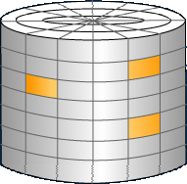

Comparison
Objects can be regarded as the convergence
of two technologies: files and blocks
Operations:
Create object
Delete object
Read object
Write object
Addressing:
[object, byte range]
Operations: Read block Write block
Addressing: Block range
Block Based Disk
Object Based Disk

Slide 5
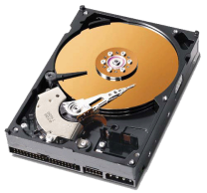
Comparison
Traditional Storage
Object-based Storage
Applications
Applications
File System
File System
Object Interface
Storage component
Logical Block Interface
Hard Drive
Object-based Storage Device (OSD)

Slide 6
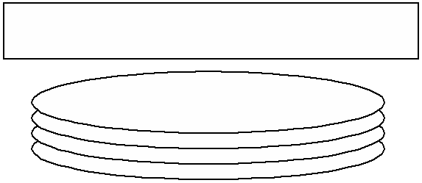
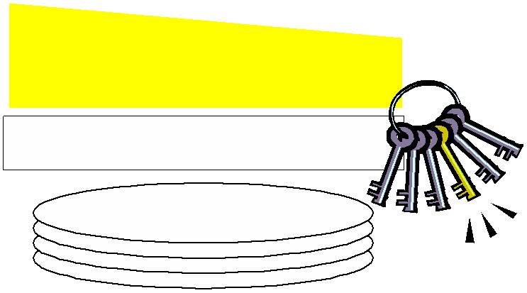
Comparison
CPU
Applications
System Call Interface
File System
User Component
File System
Storage Component
Block I/O Manager
Storage Device
(a)
Traditional model
(b)
Object storage
model
Two changes :
Object-based storage offloads the storage component to the storage device
The device interface changes from blocks to objects
CPU
Applications
System Call Interface
File System
User Component
Object Interface
Block Interface
File System
Storage Component
Block I/O Manager
Storage Device

Slide 7

Motivation
Improved device and data sharing
– Platform-dependent metadata moved to device
•
• Improved scalability & security
– Devices directly handle client requests
– Object security
• Improved performance
– Data types can be differentiated at the device
• Improved storage management
– Self-managed, policy-driven storage
– Storage devices become more autonomous
Objects

Slide 8
Outline
What is object based storage ?

Slide 9
What is OSD
In Object-based Storage Device space allocation, free space management etc., functions are no longer part of the application-side file system this to enable the creation of scalable, self-managed, protected and heterogeneous shared storage for storage networks.
Applications
File System
Object Interface
Storage component
Object-based Storage Device (OSD)

Slide 10
What is an Object-Based Storage
Storage devices that operate at object-level
Traditional storage devices (Such as DAS, SAN) operate at block-level
Objects are typically files which match the semantic level that applications manipulate data.
In traditional systems, files are mapped to blocks before they are stored in storages.

Slide 11
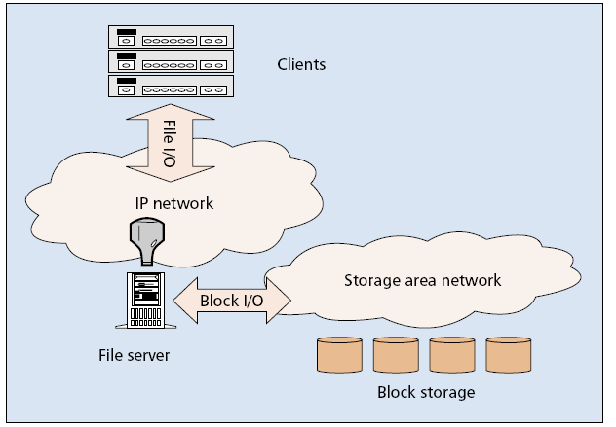
Background – NAS sharing
NAS being used to share files among a number of clients
Disk subsystems provide block‐oriented storage.
All functions can be removed that are not necessary for the file serving therefore low installation and maintenance cost.

Slide 12
Why Object-Based Storage (1/2)
Drawbacks for NAS
  Most of the processing on file access are on the file server => Poor scalability
  Each file must pass through the internal buses of the file servers twice before the files arrive at the computer where they are required.
  the load distributed to each server may be very uneven.

Slide 13
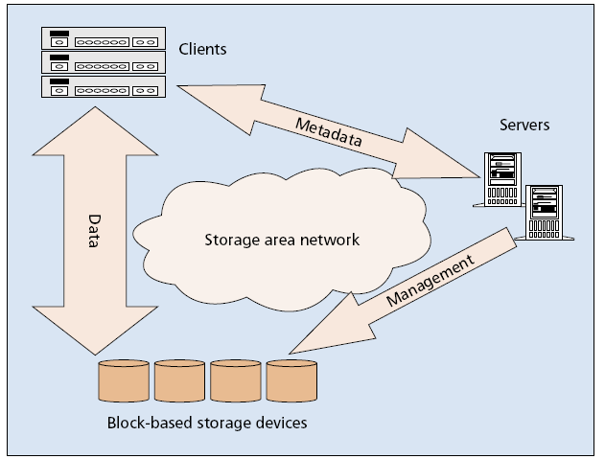
Background – SAN sharing
The files themselves are stored on a fast SAN (e.g., iSCSI) to which the clients are also attached
SAN are often used to mean a storage area network that is built up using Fiber Channel.
While the file server is removed as a bottleneck, security is a concern !

Slide 14
Why Object-Based Storage (2/2)
Drawbacks of SAN
  SANs operate at block-level, so sharing data between applications may still need upper layer software.
    file read/write sharing
    Record/file locking
Object-Based Storage can potentially eliminate both the drawbacks of NAS and SAN

Slide 15
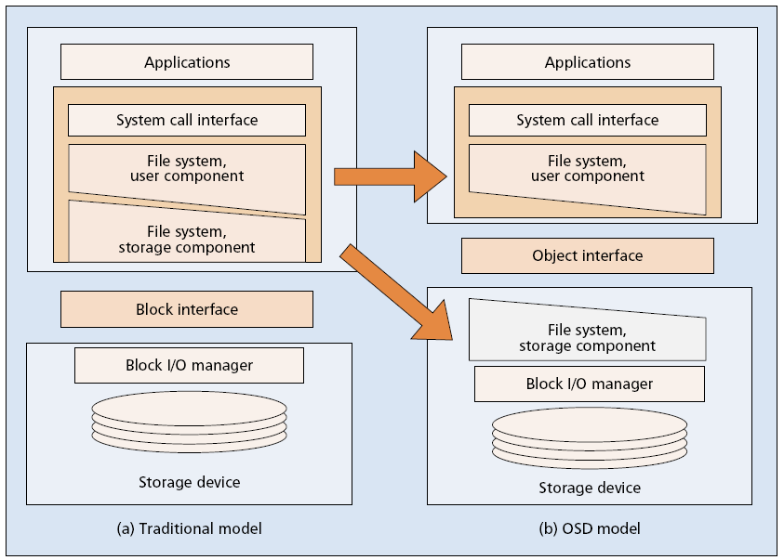
Object Storage Interface
OSD model is simply a rearrangement of existing data management functions
  OSD is a level higher than block access but one level below file access

Slide 16
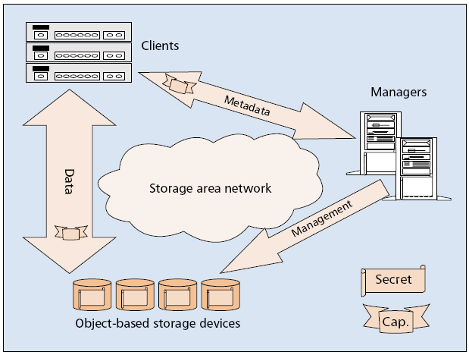
Object-based storage security architecture
Metadata managers grant capabilities to clients; clients present these capabilities to the devices on every I/O to ensure security
Secure separation of control and data path !

Slide 17
File System – Application side (User Component only)
The OSD has the intelligence to perform basic data management functions such as space allocation, free space management etc., those functions are no longer part of the application-side file system.
Thus the application side file system is reduced to a manager : an abstraction layer between user application and the OSD.
  Only provides security and backward compatibility

Slide 18
File System - On the Device (Storage Component)
Workload offered to OSDs may be quite different from that of general-purpose file systems
At the OSD level, objects typically have no logical relationship, presenting a flat name space
General-purpose file systems, which are usually optimized for workloads exhibiting relatively small variable-sized files, relatively small hierarchical directories, and some degree of locality are not effective in this case

Slide 19
Object based File System
An object-based file system splits file metadata (such as the filename, its size and access times) from file data and stores them on different servers Distribution and replication of a file across a sequence of objects on many OSDs.
File metadata is stored on metadata servers, the file data is split into so-called objects and stored on object storage servers.

Slide 20
Object based File System
The object-based file system architecture has several advantages:
(i) The file system client accesses file content directly via object storage servers. Metadata servers are only contacted once when the file is opened, thereby eliminating the metadata bottleneck of block-based distributed file systems.

Slide 21
Object based File System
(ii) The size of these objects can usually be configured on per-file basis. This allows the stripe width to be adapted to the access properties of an individual file when the objects of a file are striped across multiple object storage servers.
Example files systems: Lustre, Panasas, Ceph

Slide 22
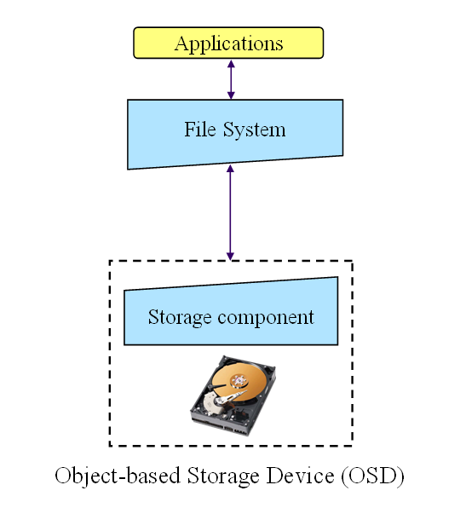


Slide 23
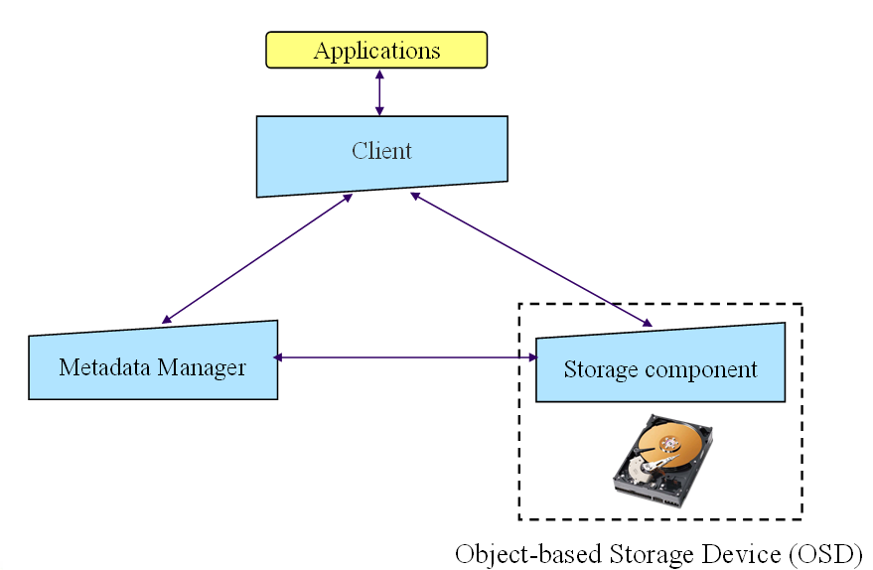

Slide 24
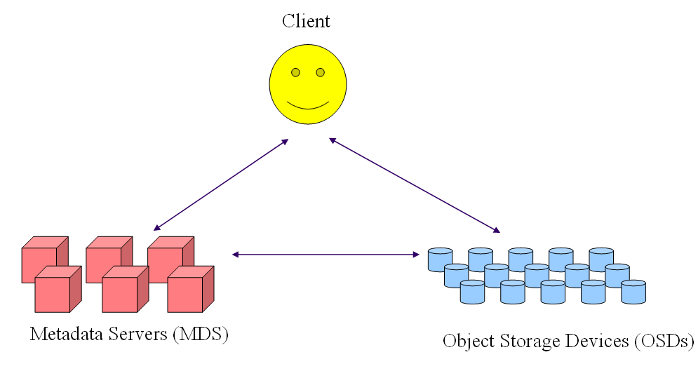

Slide 25
Lustre
A system developed at CMU, a very early working system demonstrate the concept of object-based storage systems.
Modifying the Linux kernel
A few number of MDSs
A large number of OSDs
Majorly targeting at the applications in large scale computing.
  Large number of users
  File service for high performance computing
Good Scalability

Slide 26
Lustre Architecture
(from CFS Inc.)
OST 1
MDS 1
(active)
MDS 2
(failover)
QSW Net
Linux OST Servers with disk arrays
OST 2
SAN
Lustre Clients
(1,000 Lustre Lite)
Up to 10,000’s
OST 3
OST 4
GigE
OST 5
3rd party OST Appliances
OST 6
Lustre Object Storage Targets (OST)
OST 7

Slide 27
Lustre Components and Functions (1/2)
Basic Components
  Client Filesystems
    Interfacing to local file system (VFS) on clients
    As MDS client
    As OST client
  MetaData Servers
    All the meta-data operations - creating new directories, files, symbolic links, or acquiring and updating inodes, are handled by the MDS.
  Object Storage Target
    All the file I/O related operations are directed to the OST’s.

Slide 28
Lustre Components and Functions (2/2)
The role of the client filesystem is to provide a directory tree, subdivided into filesets, which provides cluster-wide Unix file sharing semantics.
The client filesystem interacts with the meta-data servers for meta-data handling, i.e. for the acquisition and updates of inodes and directory information.
File I/O, including the allocation of blocks, striping, and security enforcement, is contained in the protocol between the client filesystem and the object storage targets.
A third protocol exists between the OST and the MDS, largely for pre-allocation and recovery purposes.

